Slide 1

1
Preschool – 1st Grade
Notes:
Navigating the Passenger Power Curriculum
There are dedicated Facilitator Guides and Slide Decks divided by age groups: PreK-1st grade, 2nd-3rd grade, and 4th-5th grade. The content is age appropriate with the same powerful message of passenger safety.
The related Passenger Power Facilitator Guide includes detailed instructions for the lessons, activities as well as printable materials to use in the presentation.
A Safety Day Lesson Plan is available using the same slides in this slide deck but spread across multiple days.

Slide 2
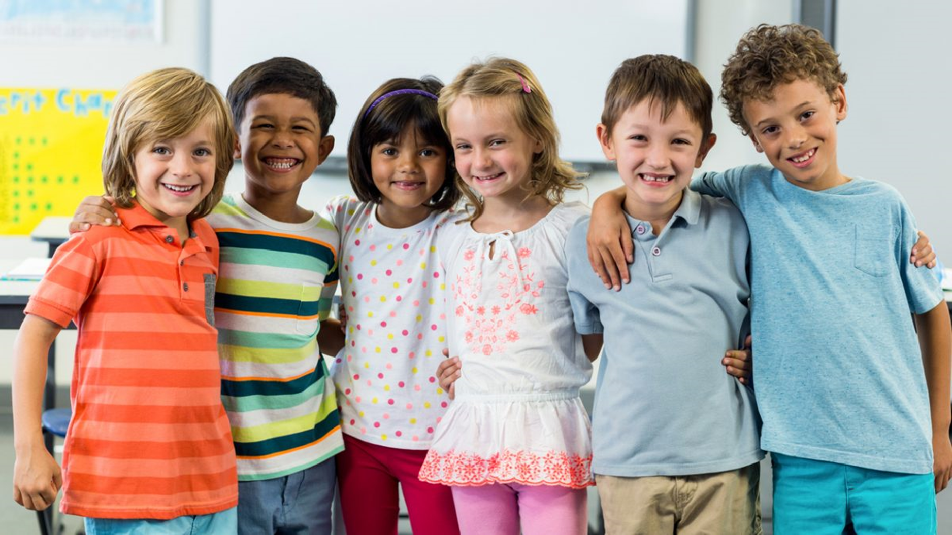
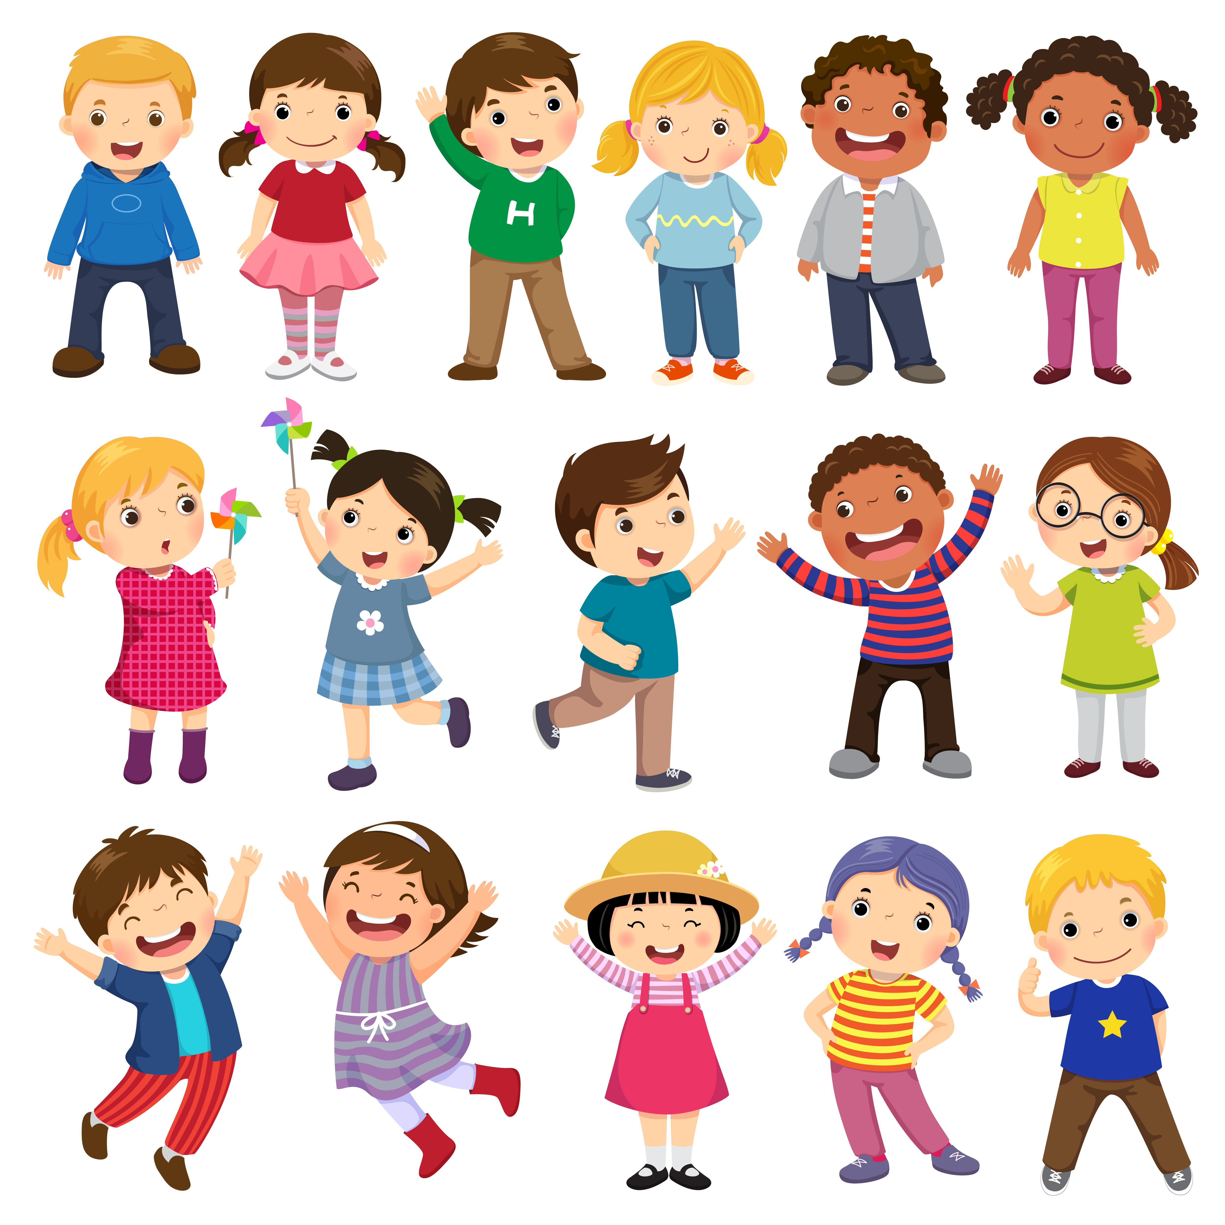


2
Passenger Power!
Notes:
Passenger Power Introduction (Slides 1-3) - 5 minutes
Introduce yourself to the class and tell them you are going to introduce them to Captain Power!

Slide 3
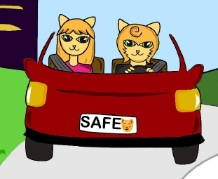
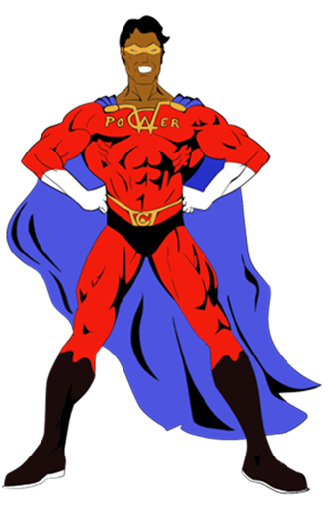
3
How Do You
Stay Safe
in the Car?
Captain Power and His Passenger Pets Want to Know…
Notes:
Continued - Passenger Power Introduction (Slides 1-3) - 5 minutes
Ask students: "Captain Power and his passenger pets want to know how you stay safe in the car?”
Follow up questions: “Who helps you stay safe in the car? How do they help you?” Encourage students to raise their hand and take 3-4 answers from the class (Look for responses similar to parent/guardian, grandparents, educator, family friends, bus driver, law enforcement officers, etc. – adapt to your audience).
Acknowledge students have some great ways they are staying safe in the car. Then tell the students they are going to learn more about how to be a super safe passenger in a vehicle!

Slide 4
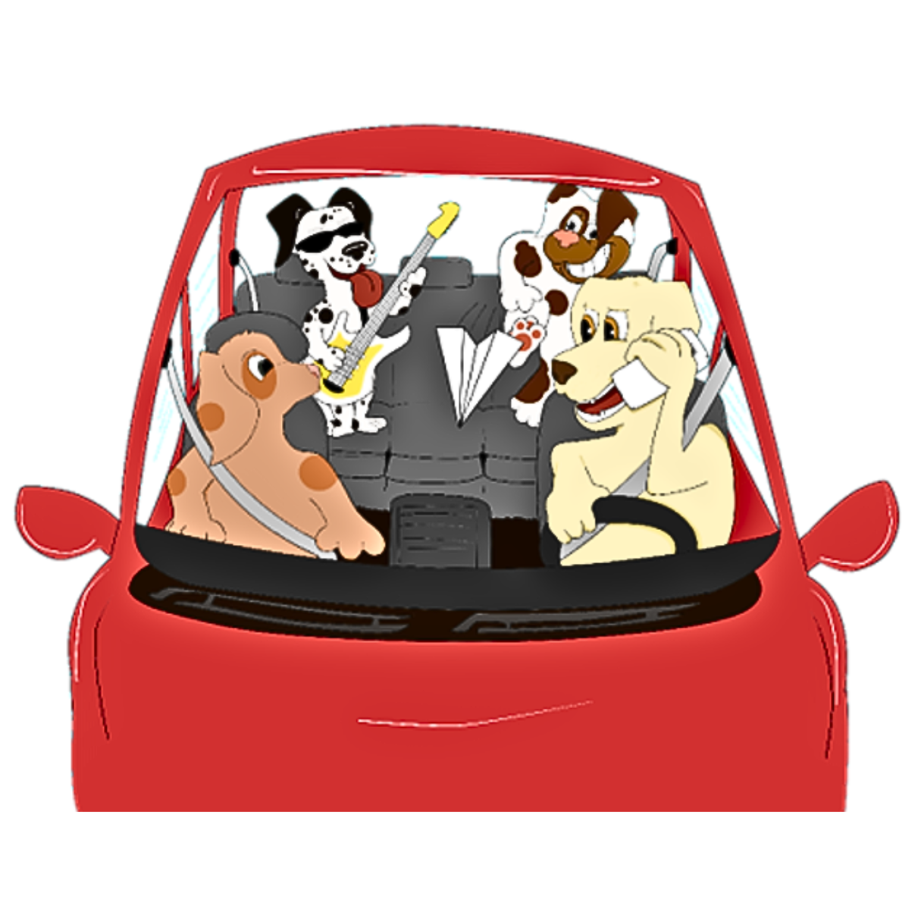
4
What’s Wrong with This Picture?
Notes:
What’s Wrong with This Picture? (Slide 4) – 1 to 2 minutes
Printable Materials Resource: you can print the matching page from the Passenger Power Facilitator Guide
Show students the distracted car ride picture and ask them to share what unsafe behaviors they see happening in the car.
As students share the behaviors they see happening in the car, highlight that each of these behaviors are distracting to the driver and the rest of the passengers.
Behaviors that should be addressed include:
Driver on phone (mind off driving, hand off wheel)
Driver looking at passenger (eyes off the road)
Front seat passenger looking at back seat (eyes off the road)
Back seat passengers unbuckled (mind off driving)
Back seat passenger throwing paper airplane at driver (eyes off road)
Back seat passenger playing loud music with guitar (mind off driving, ears not alert)
Back seat passengers standing up and not sitting in the seat/car seat (mind off driving, eyes off road)

Slide 5
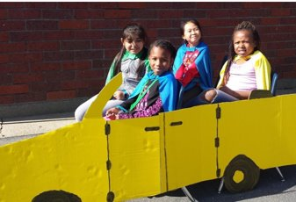
5
Safe Car Ride - Unsafe Car Ride
Stay in character.
Go until you hear “FREEZE.”
Notes:
Safe Car Ride, Unsafe Car Ride Activity (Slide 5) - 15 minutes
Activity Resource: a printable version of the instructions for this activity is in the Passenger Power Facilitator Guide
This activity will require 5 students to participate. You can pick students or ask the educator to pick 5 responsible volunteers.
Materials: Arrange five chairs in the front of the room with two chairs in the front and three in the back (to resemble the layout inside a car). Props can be used such as a steering wheel, seat belts, costumes, etc.
Roles: There will be two different skits, the first will be an unsafe car ride and the second will be a safe car ride. Assign roles by whispering in their ear what role you want them to play. There are some examples of roles listed below.
Driver
Keeps looking at the back seat to see what is going on
Who can’t find a good song on the radio and keeps looking away to change the station
Front seat passenger
Wants to sing every song as loud as possible and take selfies on their phone.
Trying to play a card game with the driver
Back seat passengers
Keeps unbuckling and getting out of their seat the whole car ride
Throwing snacks around the car and at the driver
Unbuckling the passenger next to them
Kicks the back of the driver’s seat the whole ride
Wants the driver to look behind them at the silly face they are making
Keeps asking Aare we there yet?”
Keeps saying they need to go to the bathroom
Scenario: Engage the rest of the class by “setting the scene” or scenario.
The driver is taking the passengers to the park.
The driver is taking the passengers to go get ice cream.
The driver is taking the passengers to go get dinner in town.
The driver just picked all the passengers up from school.
The driver is taking the passengers to camp.
The driver is taking the passengers to school.
When the class is ready, start the “unsafe car ride” scene and allow the students to play out their roles for about 1 -2 minutes.
Tell students to “FREEZE” and ask the audience to share what they saw that was bad or unsafe behavior in that car ride (optional: record student responses on the board, flipchart, etc.)
Make sure major distractions are addressed from the back seat passenger role examples provided above (ie. Playing the music too loud, asking the driver to turn around and look at you, throwing something at the driver, kicking the back of the driver’s seat, etc.) If not, say “What about… [any distraction that was not mentioned]? Ask, “Is there anything they DID NOT do?” to make it a safe car ride?
Now tell the students that they are going to show the class what a “safe car ride” looks like and allow students to play out their roles for about 1-2 minutes.
Explain to volunteers this time around they should make safe choices starting with putting on their seat belt (stay seated, talk quietly, not use cell phones, and the driver puts both hands on the wheel).
Allow the students to play out their roles for about 1 -2 minutes.
Tell the volunteers to “FREEZE” and praise them for doing a much better job at being safe in the car! Ask the students to share the safe behaviors they saw in the car. Be positive and upbeat!
If you choose, record student responses on the board or a flipchart.
Responses can be displayed in the classroom to remind students of the importance of being a safe passenger every time they get into the car.

Slide 6
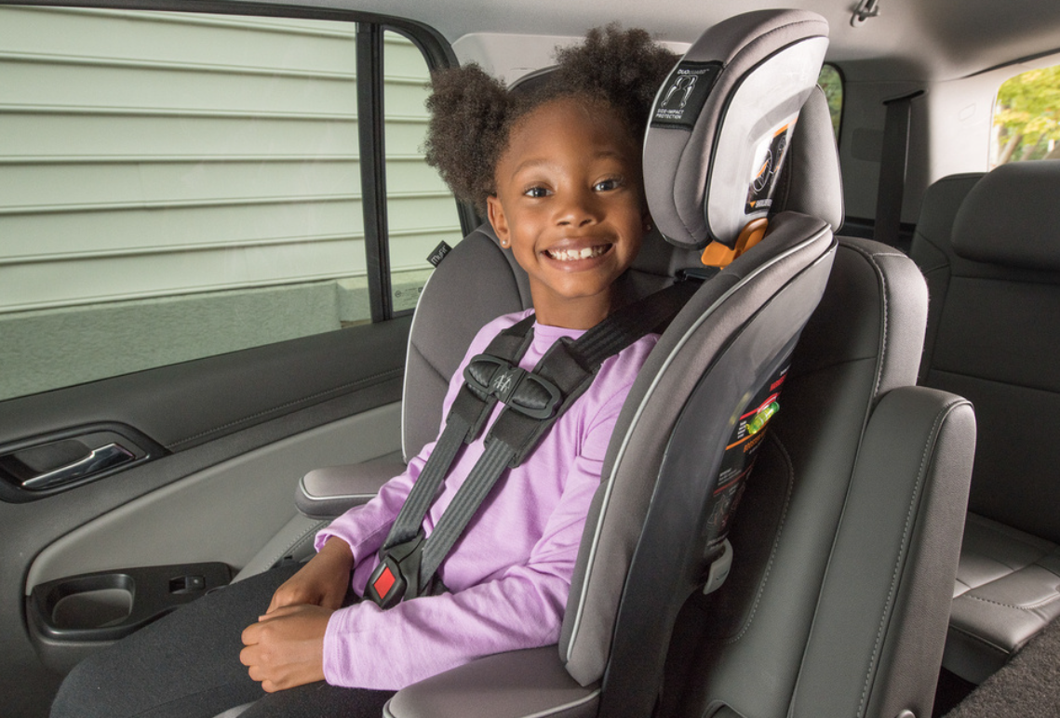
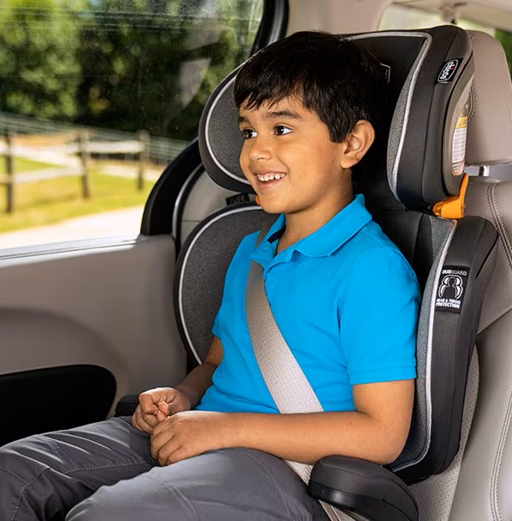
Passenger Power!
6
Car Seat!
Buckle!
Passenger Power!
Notes:
Passenger Power Safety Cheer (Slide 6) - 3 minutes
Activity Resource: a printable version of the instructions for this activity is in the Passenger Power Facilitator Guide
With enthusiasm, praise the students for showing a great car ride and how all the passengers did a great job using their voices, wearing seat belts, and staying in their car seats and booster seats.
Ask students: “Why is it important to wear seat belts in the car?
Get answers from students. A seat belt helps keep you safe.
Remind students that every time they ride in the car, they should buckle up and how if someone in the car is unbuckled or not wearing their seat belt correctly, they could get hurt.
Conclude with “To keep us all safe, Captain Power created the “Passenger Power” Safety Cheer! You are going to learn it today! Ready?” (have students stand up – after demonstrating, you can break into groups and compete for the loudest cheer)
How to do the Passenger Power Safety Cheer
“Car Seat!”/ “Booster Seat” Reach to your shoulders with both hands to demonstrate the chest straps.
“Buckle!” Reach to your lap and pretend to buckle the car seat.
“Passenger Power!” Put both arms in the air with excitement!
OR
“Seat Belt!” Reach across your chest to your shoulder where you would grab the seat belt.
“Buckle!” Reach across your chest with the seat belt as if you were to buckle in.
“Passenger Power!” Put both arms in the air with excitement!

Slide 7

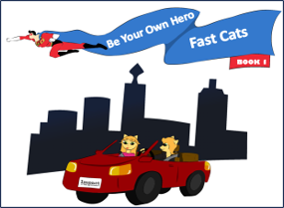
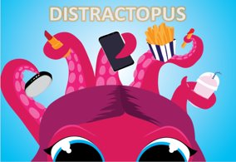
7
Notes:
Circle Time/Read Aloud (Slide 7) - up to 10 minutes
Activity Resource: a printable version of the instructions for this activity is in the Passenger Power Facilitator Guide within the Classroom Presentation section
Select one of the three ITD children’s books to read to the students: Distractopus, Fast Cats, Passenger Pets
A free electronic version of the book can be downloaded following these steps:
Visit the website https://impactteendrivers.org
Pause on the top banner option “Our Programs” then from the menu displayed click on “Elementary School”.
Click the “View Our Elementary School Education Resources” button
The first time you click on a downloadable resource a “Restricted Content” window will appear.
Have the students join you on the rug or in an area where they can see.
Read the story out loud! Be fun and creative to engage students! The first page of the book includes messaging that the students should take away at the end of the story.
When you finish the book, ask students to share their favorite part of the story and tie it back to important messaging about being a safe and responsible passenger. You can read a different book on three different days throughout the week.

Slide 8
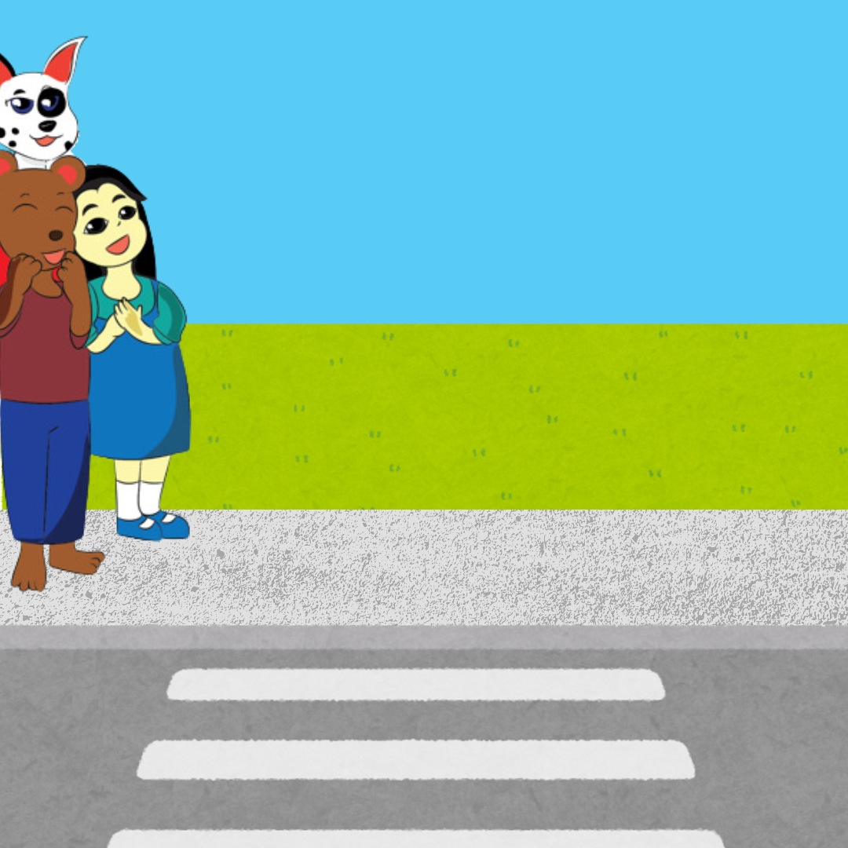
8
How Do You
Stay Safe
on the Sidewalk?
Captain Power and the Pets Want to Know…
Notes:
Connection to Pedestrian Safety (Slide 8 & 9) – 4 to 5 minutes
On Slide 8: Ask students: "Captain Power and the pets want to know how you stay safe on the sidewalk?” Ask a follow up question: “How is this similar to staying safe in the car?”
Encourage students to raise their hand and take 3-4 answers from the class.
Listen for answers like looking both ways before crossing the street, wearing a helmet when on a bike or scooter, or looking and listening for cars.

Slide 9
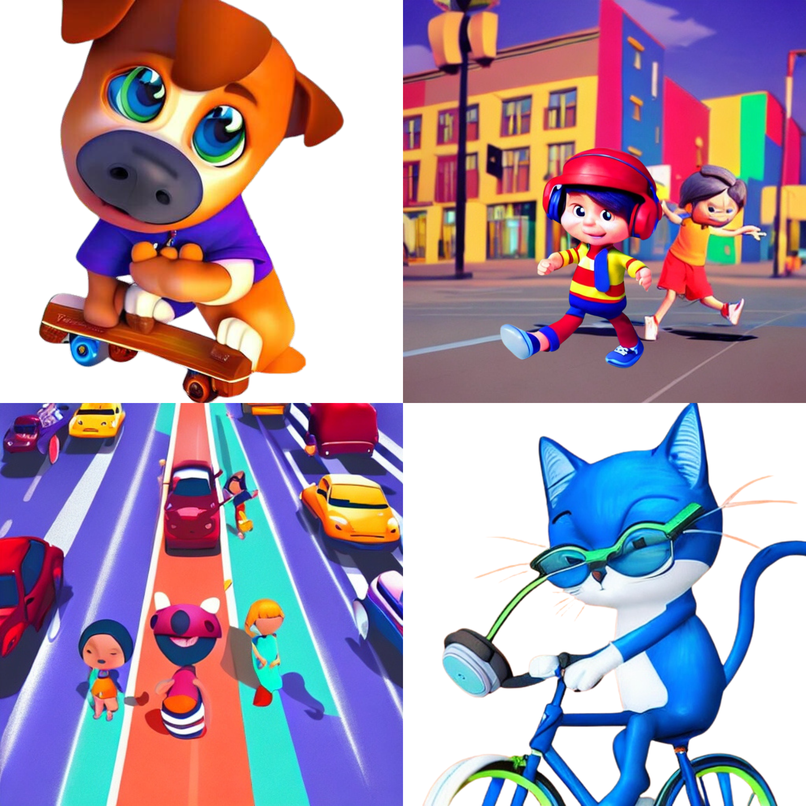
9
What’s Wrong with This Picture?
Notes:
Continuation - Connection to Pedestrian Safety (Slide 8 & 9) – 4 to 5 minutes
On Slide 9: Ask them to share what unsafe behaviors they see happening in the example picture of walkers, bike riders, and skateboarders.
Make the direct connection for the follow up question: “By using your looking eyes, listening ears, and wearing a helmet while on a bike, scooter, skates or skateboard, you can be safe on the sidewalks. This is like how we can stay safe in the car! The driver is focused, the passengers are calm, and everyone wears their seat belt!
Optional: If the group is playing Red Light, Green Light next, use this segue: “Now we’ll practice being focused and using looking eyes and listening ears while playing a game.”

Slide 10
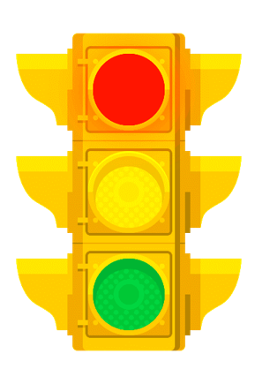
10
Red Light - Green Light
Fast walk only. No running.
If you touch an object,
go back to the start and try again.
Notes:
Red Light, Green Light Activity (Slide 10)- up to 10 minutes
Optional based on time and space
Detailed instructions can be found on the related Activity Sheet later in the related Passenger Power Facilitator Guide.
There is a printable template within the Activities section of the guide to use in creating the signs.

Slide 11
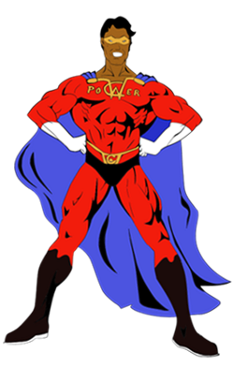
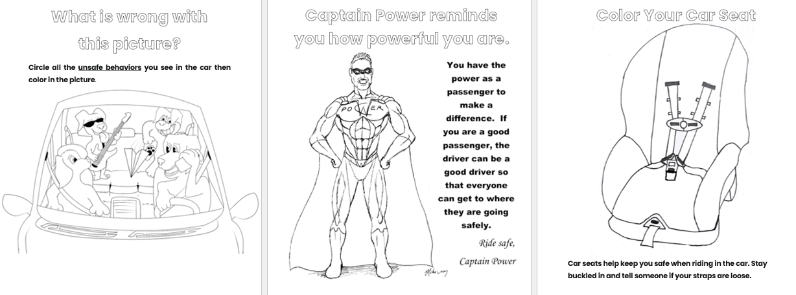
11
Notes:
Coloring Activities (Slide 11) - up to 10 minutes
Optional based on time
Pass out coloring pages that can be done in the classroom or use as a take-home activity.
There are multiple coloring pages within the Printable Materials section of the related Passenger Power Facilitator Guide.

Slide 12



Use Your Passenger Power To Keep Everyone in the Car Safe!
12
Buckle Up
Stay in Your Seat
Speak Up if You Feel Unsafe
Don’t Distract the Driver
Thank You!
Notes:
Wrap Up (Slide 12) - 2 minutes
Thank the students for their attention and participation. If you are a visitor, thank the educator for allowing you to come into the classroom.
Remind the students to be safe passengers and to speak up if something unsafe is happening in the car.
Say: “Let’s do the Passenger Power Cheer one more time!” (or more if you have time for it) “Car Seat!” “Buckle!” “Passenger Power!”

